Slide 1
Introduction to Tableau
Allison Xu
Data and Visualization Librarian
allison.xu@bc.edu

Slide 2
Overview
Download & Install Tableau
Introduction
Prepare data to transform to a visual
Work with Tableau
Intro to Tableau Interface
Connecting to data
Create the visual
Overview of a worksheet
Create worksheets
Create an interactive dashboard
Save/Publish
Additional Resources

Slide 3
Step 1: Download & Install Tableau
Everyone can download Tableau Public for free from https://public.tableau.com/en-us/s/download
Once it’s installed, go to https://public.tableau.com/s/ to sign up for an account/profile.
Tableau Academic Program:https://www.tableau.com/academic
The student/Instructor license expires after one year; you can request a new license each year as a full-time student.

Slide 4
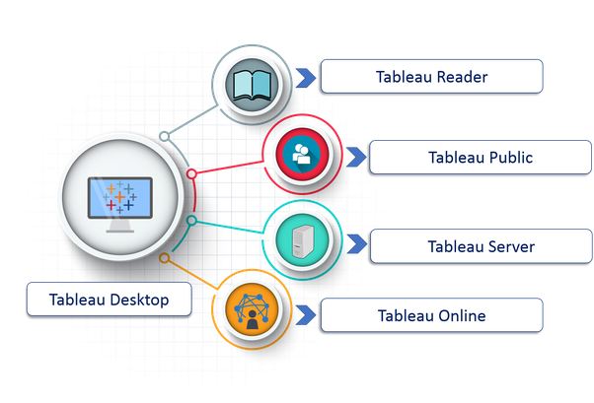
What is Tableau?
An interactive data visualization software that allows you to tell a story about your data.

Slide 5
Tableau Family
Tableau offers five main products which are:
https://www.tableau.com/products
Developer Tools
Tableau Desktop
Tableau Public
Sharing Tools
Tableau Server: Collaboration in organizations
Tableau Reader: Let you read files saved in Tableau Desktop
Tableau Online: Similar to Tableau Server (On Cloud)

Slide 6
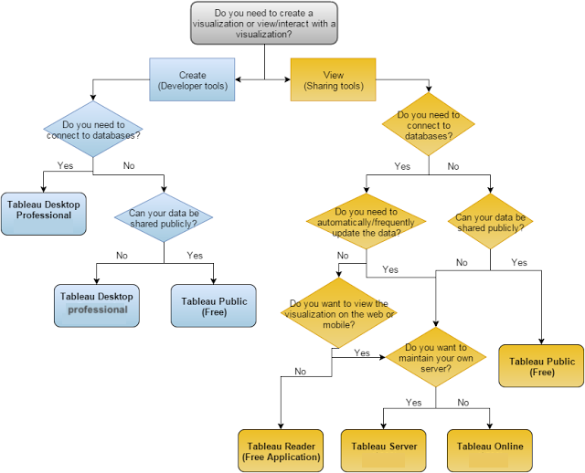

Slide 7
Tableau file types:
Tableau Workbook (.twb)
It relies on a live data source connection and doesn't contain the actual data within the workbook file.
Tableau Packaged Workbook (.twbx)
It contains both the Tableau workbooks and the data!
Notes:
There are a variety of file types when using Tableau, (workbooks, bookmarks, packaged data files, data extracts, and data connection files) I am not going to confuse you by telling you all of the file types, but I think it is better to know the most common file types.

Slide 8
Workbooks are made up of:
Worksheet(s):
Worksheets are where you create your visualization.
Dashboard(s):
It is a canvas that displays one or more worksheets.
Example: Visual Vocabulary by Andy Kriebel
Story(s):
Enables you to snapshot visualizations and step a user through a story.
Example: Race to Alaska by Anthony Gould

Slide 9
Step 2: Getting Started with Tableau
The dataset we will use in this workshop can be downloaded from https://github.com/BCDigSchol/coffee-code
2017 Boston Marathon Runner Statistics

Slide 10
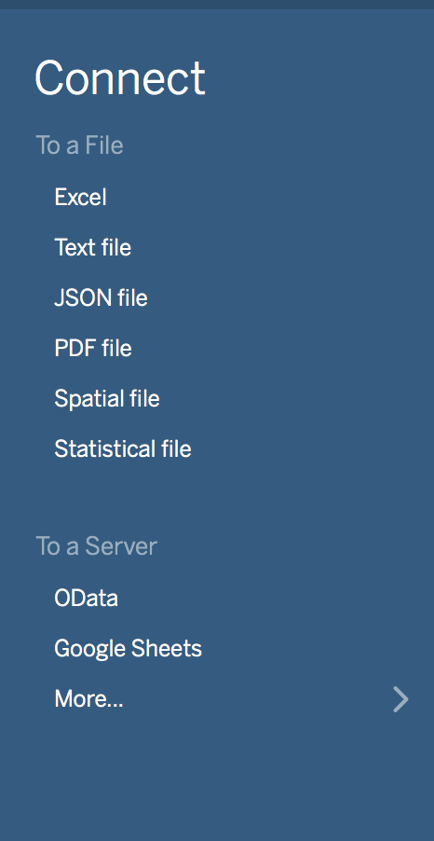
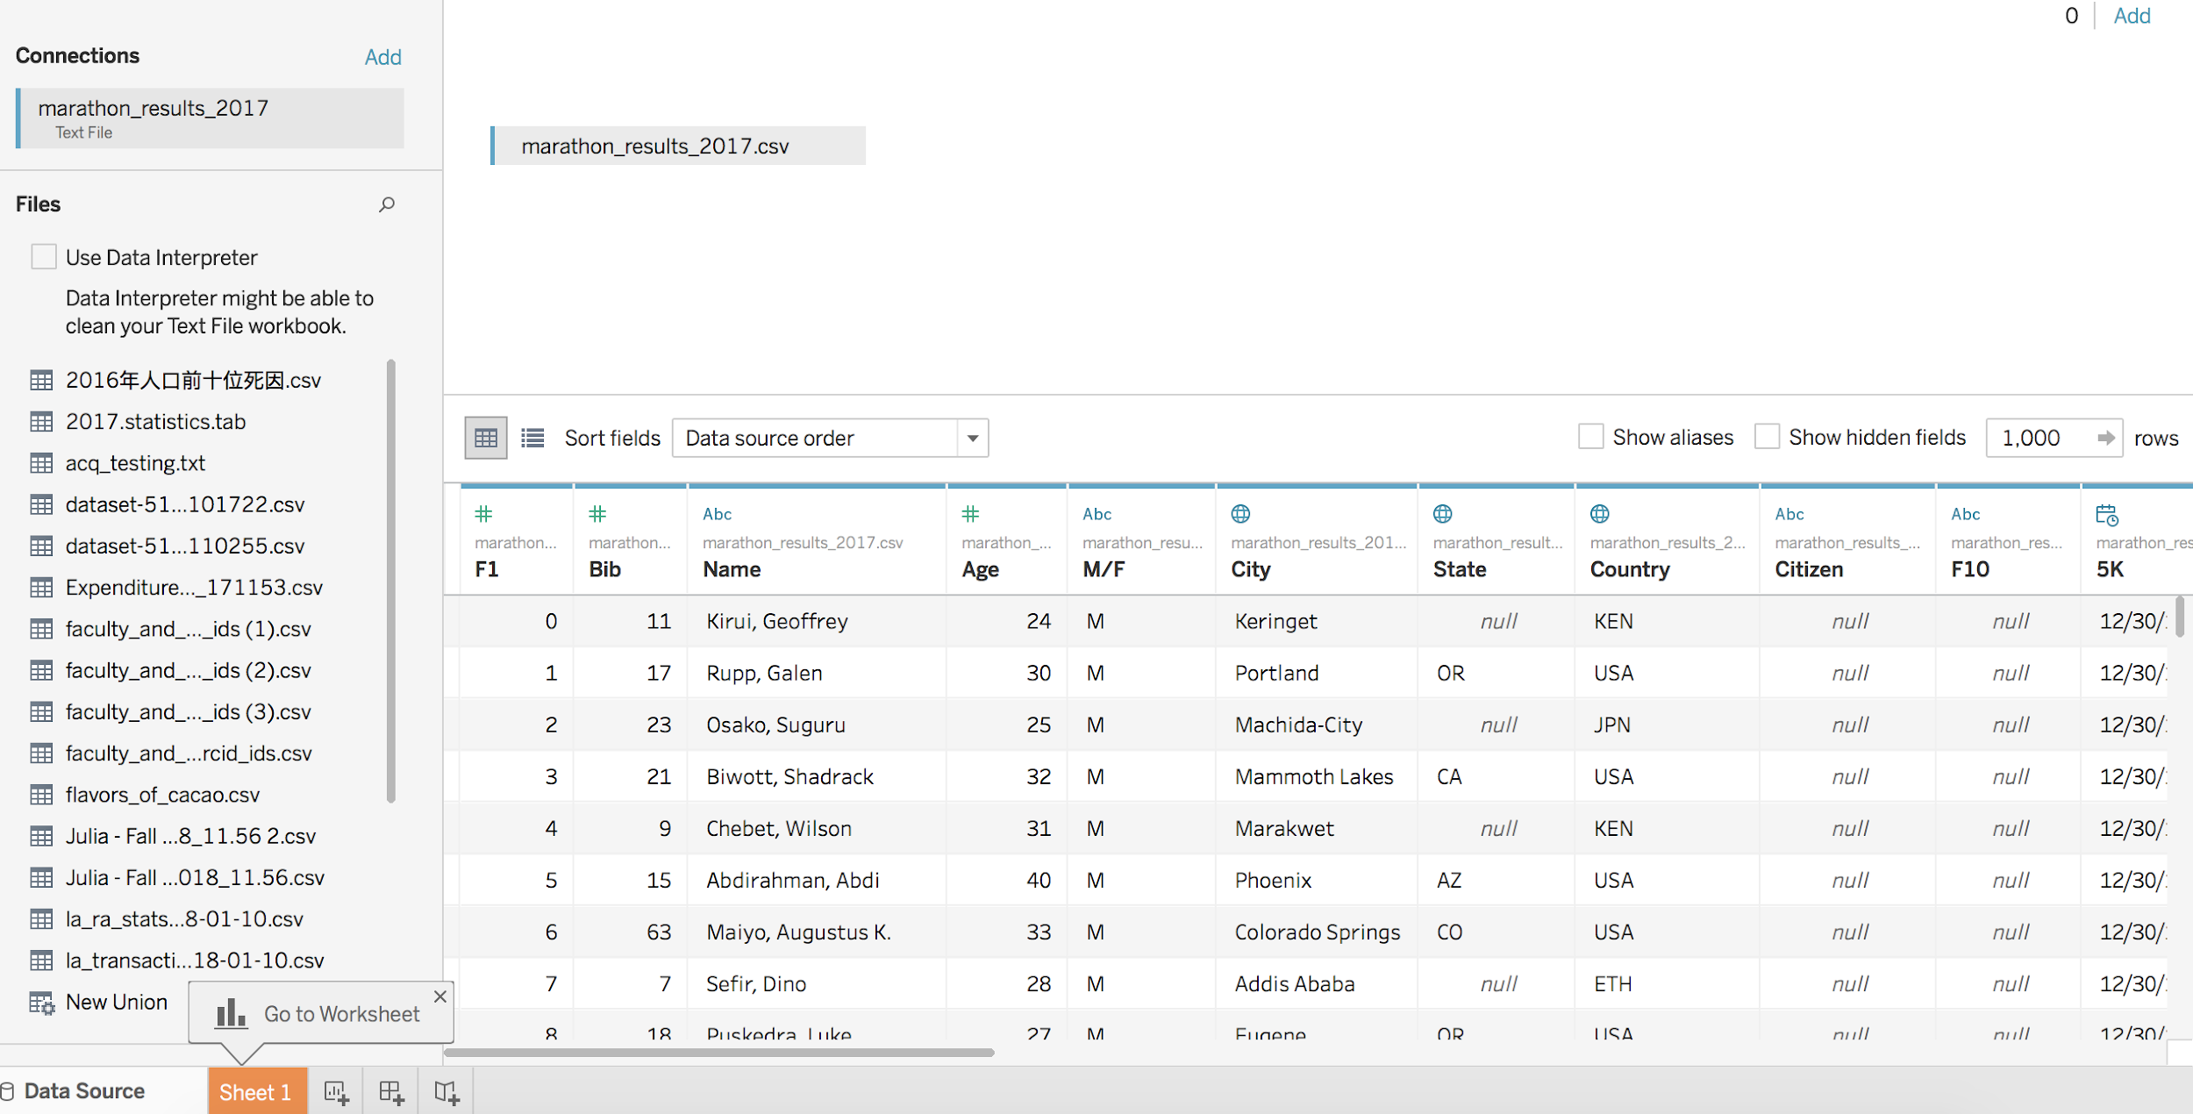
Step 3: Connecting With Data
To connect to an excel file, click “Excel” on the left hand side. Navigate to the file on your computer and double click to open it.

Slide 11
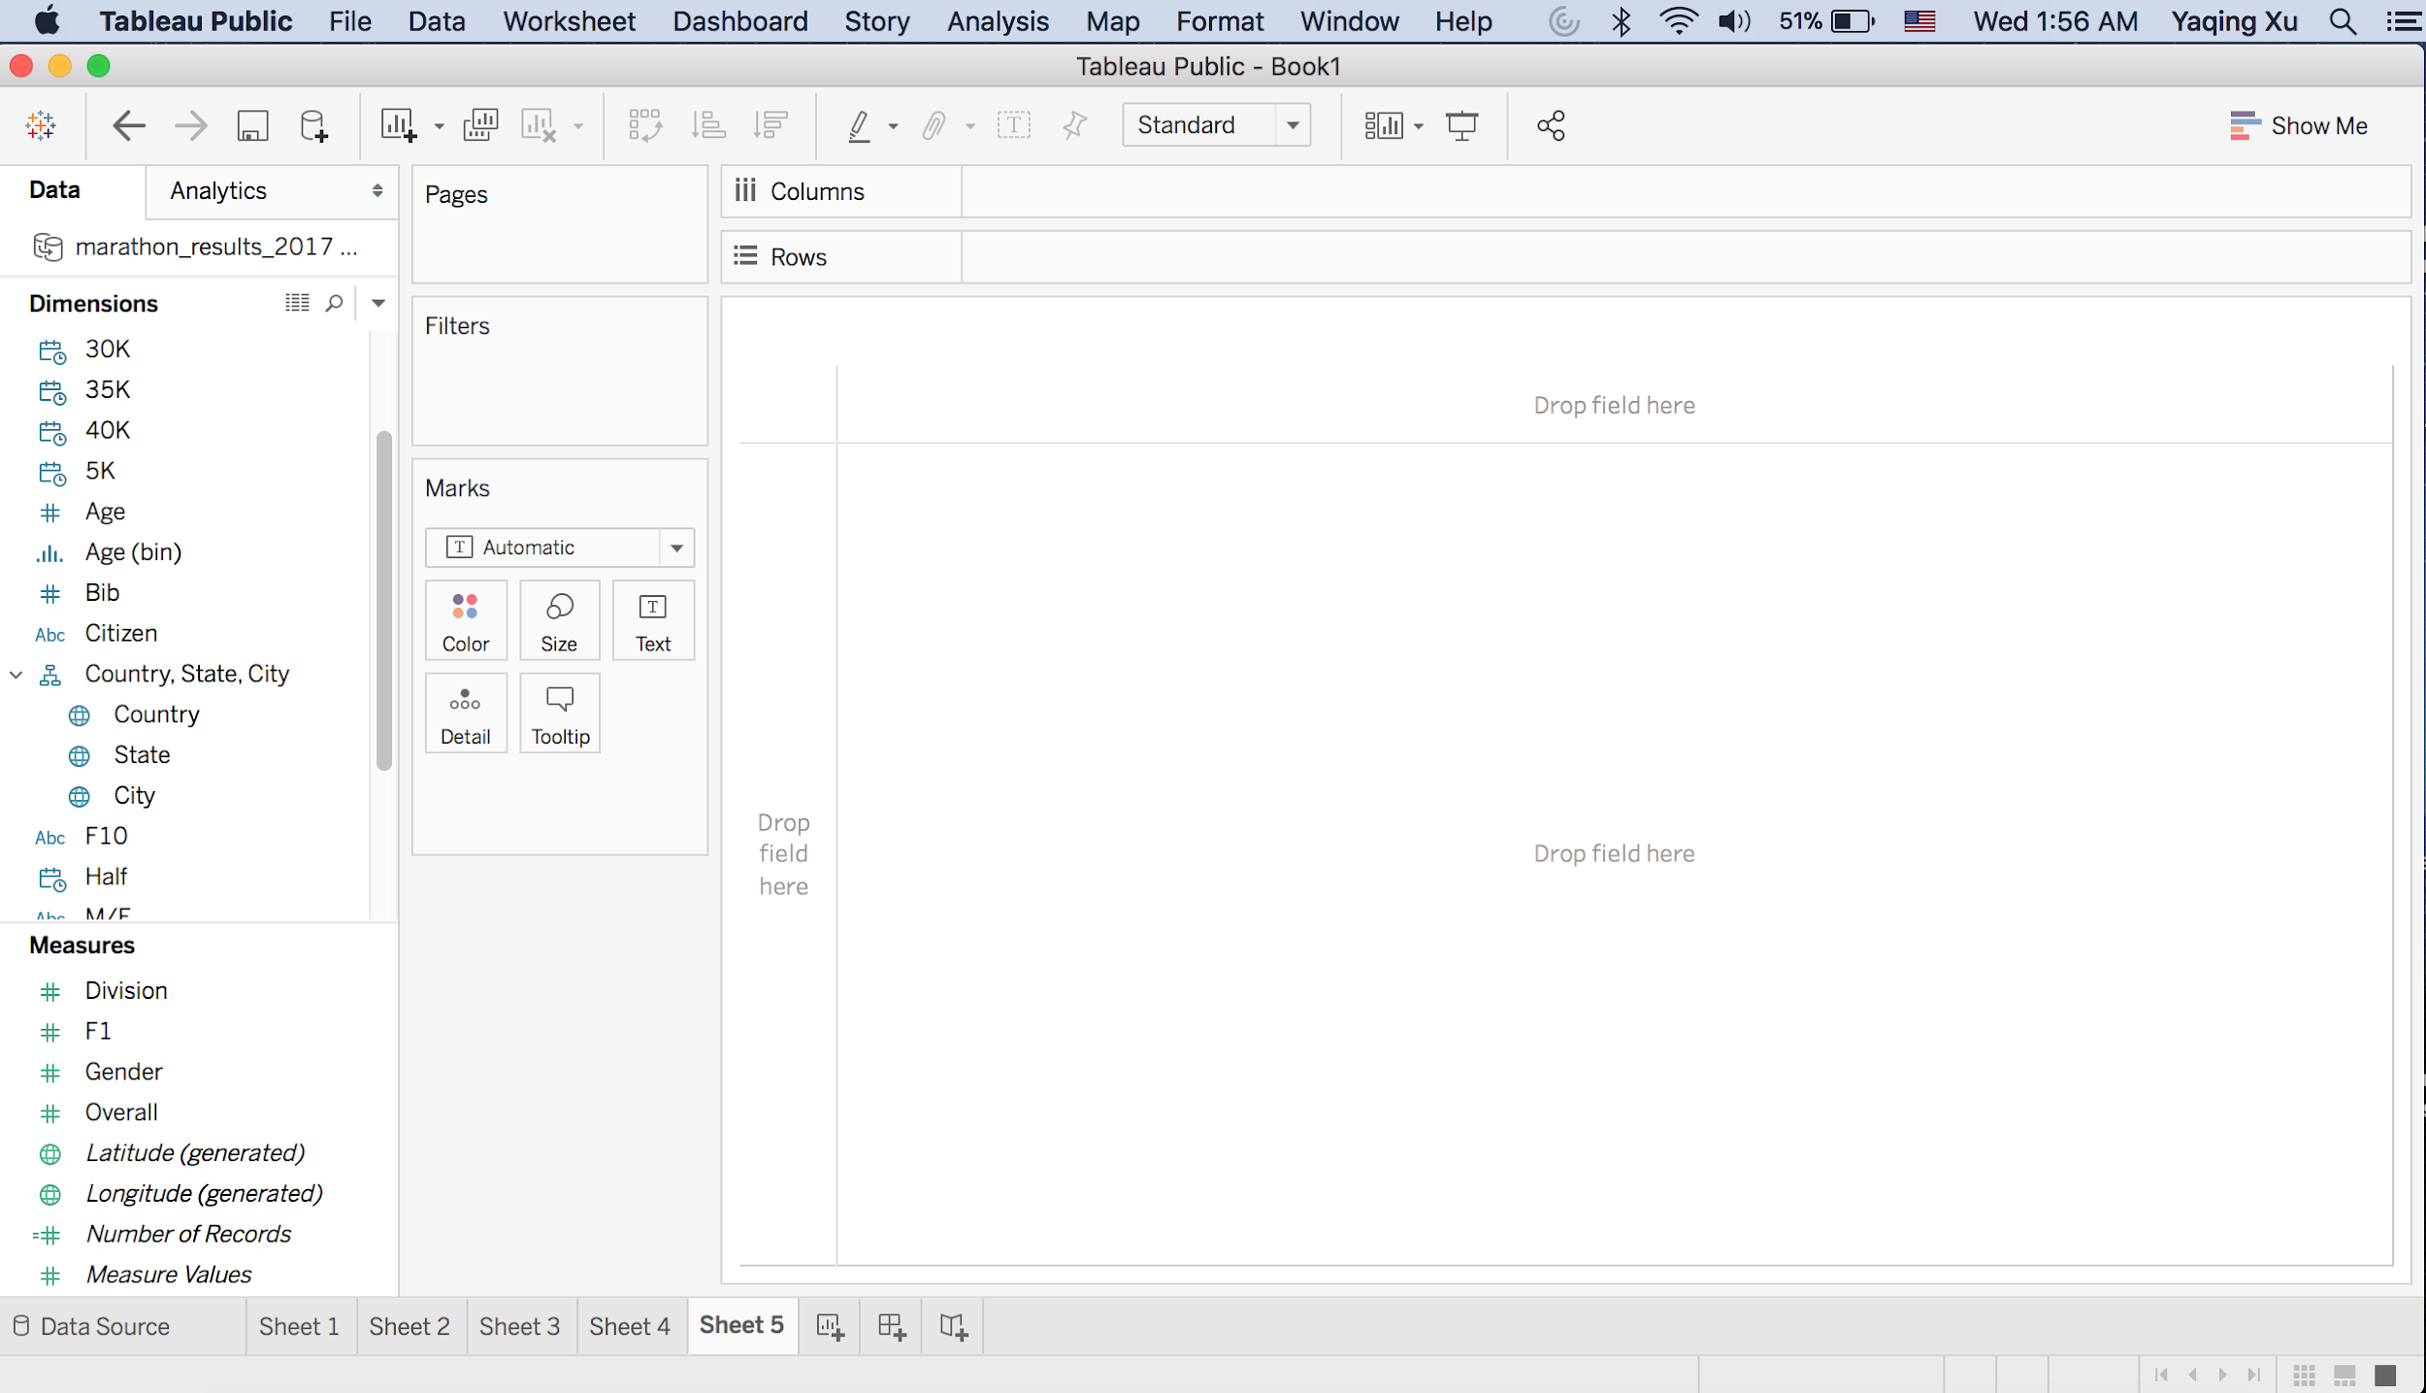
Step 4: Tableau Workbook Interface

Slide 12
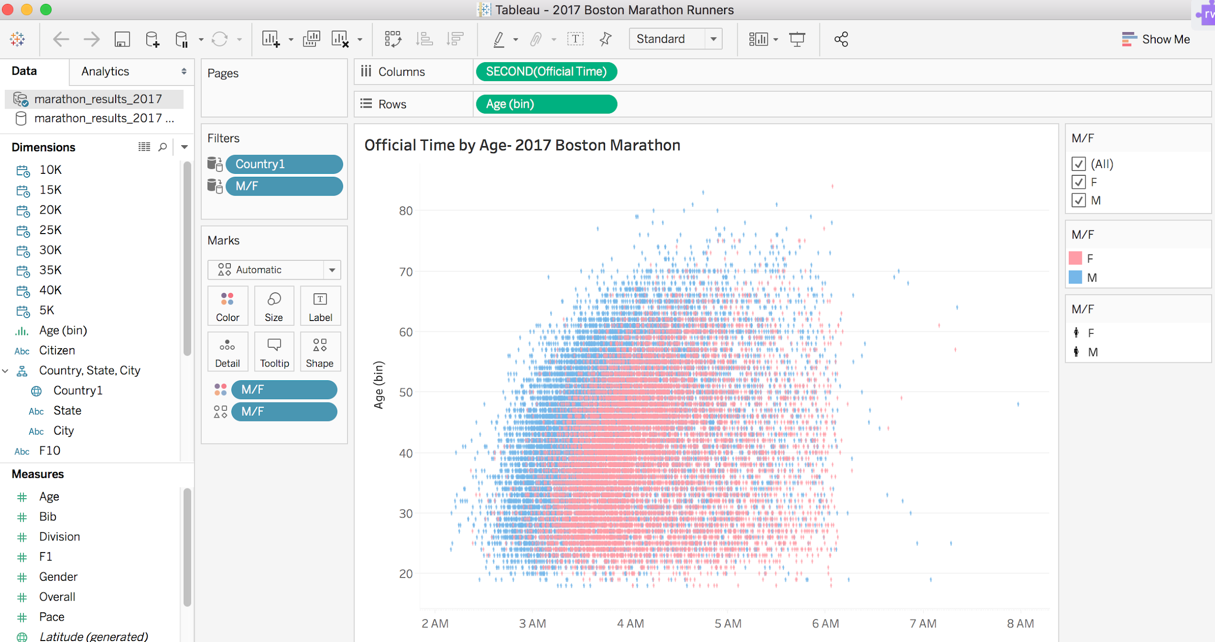
Step 5: Creating Views and Analysis

Slide 13
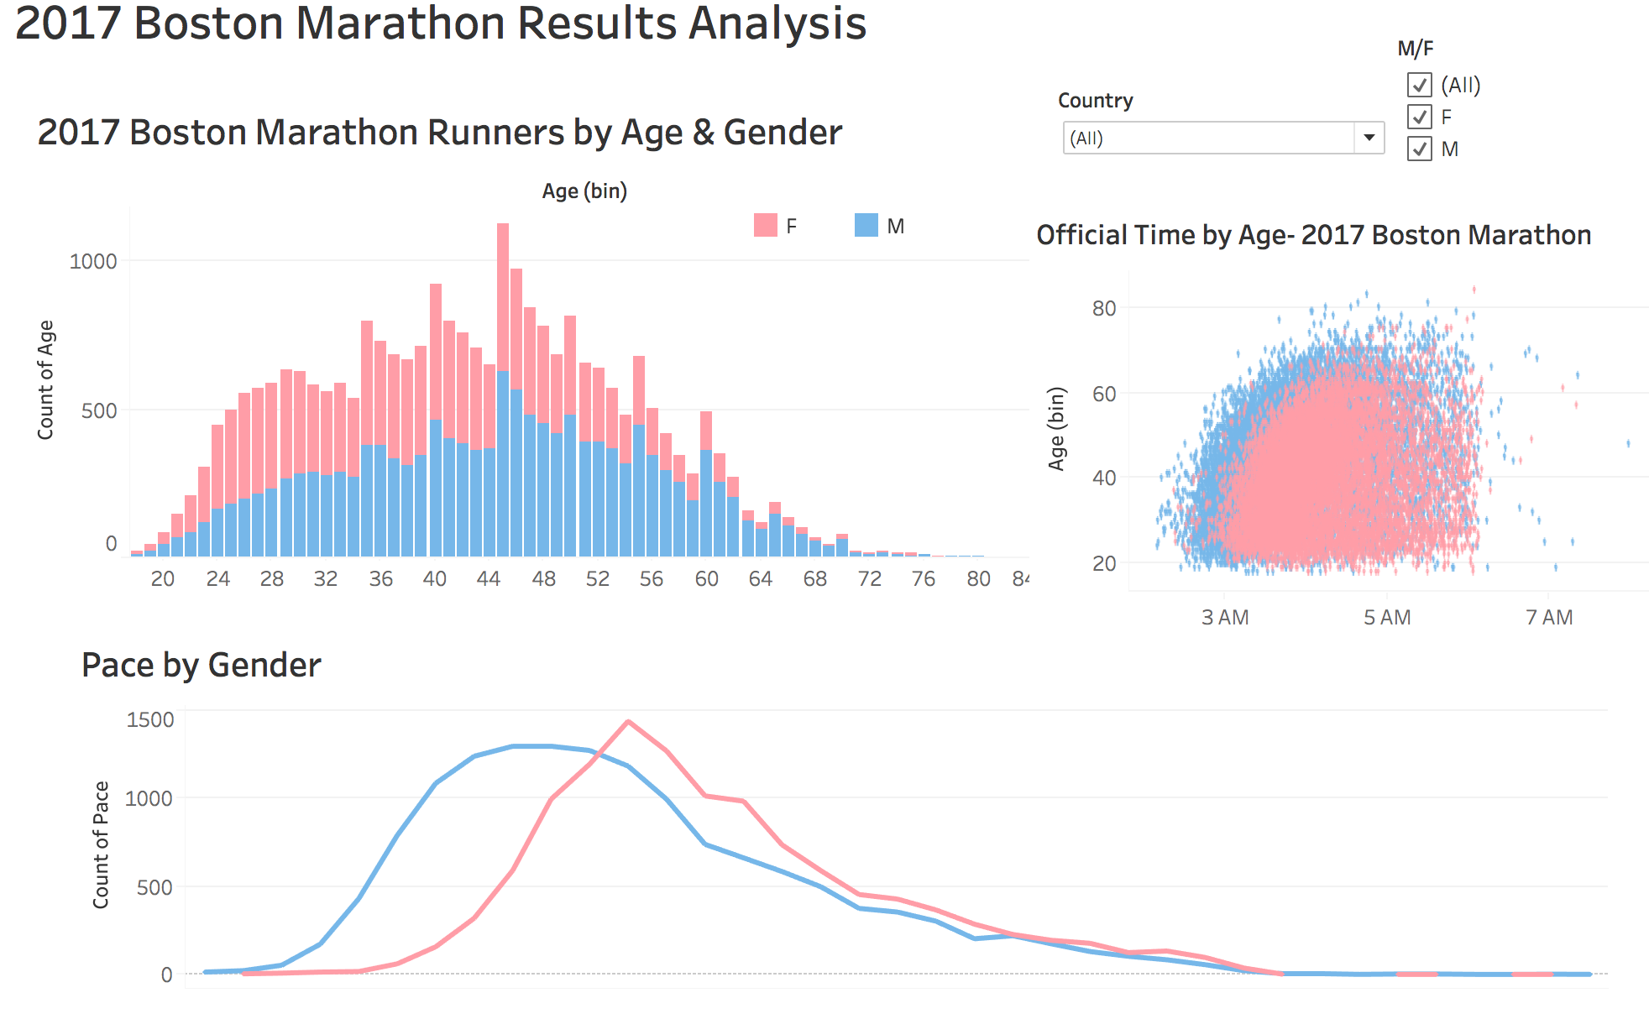
Step 6: Create an interactive dashboard

Slide 14
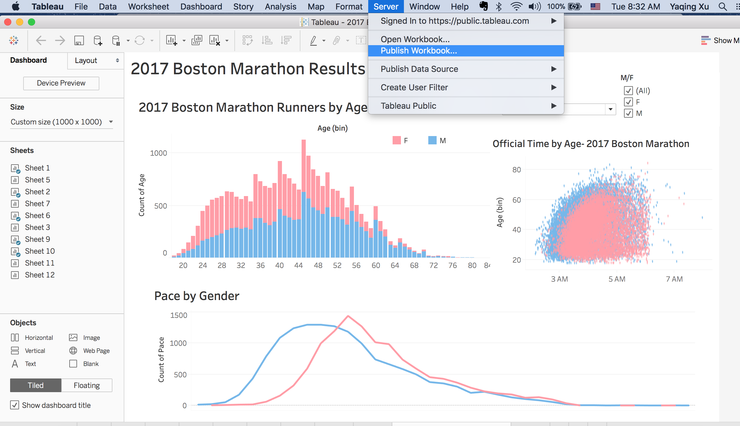
Step 7:Save and Publish

Slide 15
Additional Resources
Tableau Community
Join the Tableau Community Forums to find solutions for what you need to accomplish. Ask questions to receive help and feedback.
Tableau Visual Gallery
Get inspired by the many interactive visualizations in the Visual Gallery. Download the workbooks to play with on Tableau Desktop
How-to Videos
Lynda.com
Notes:
Now that you have good understanding of Tableau, it’s time to become a part of Tableau communities. This will help you a lot to enhance your learning, get answers to questions and simplified description for complex topics by bloggers.

Slide 16
THANKS!
Any questions?

